Slide 1



App development with Swift
Hayden & Dipesh

Slide 2
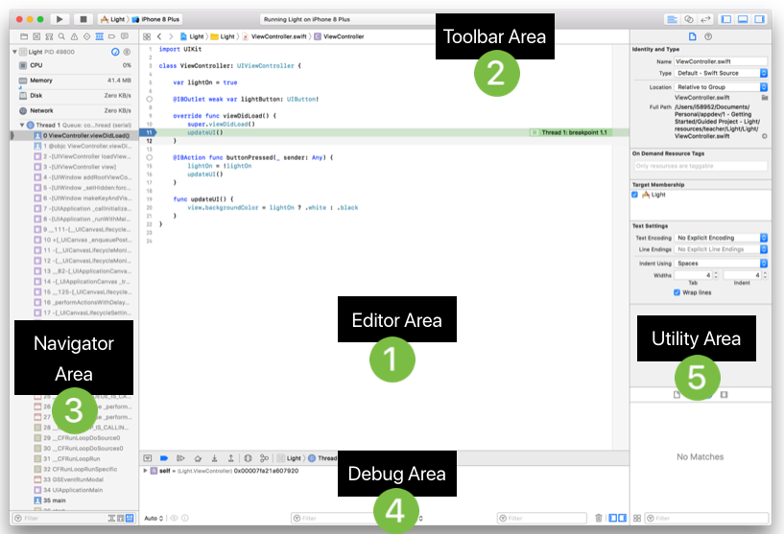
Notes:
Editor Area – Edit your source code, Add breakpoints.
Toolbar Area – Build and run
Navigator Area – See project structure
Debug Area – Console area and add print statements as well.
Utility area - Add components and information about your view controller.

